Slide 1
W3C Web of Things Summary and Applications
Michael McCool
February 2022

Slide 2
Outline
What is WoT?
Applying and extending web standards for IoT
Descriptive interoperability: Thing Descriptions
Finding Thing Descriptions: Discovery
Use Cases and Applications
Use Cases and Requirements
Smart Buildings
Smart Cities
Discussion
Gaps and Future Work

Slide 3

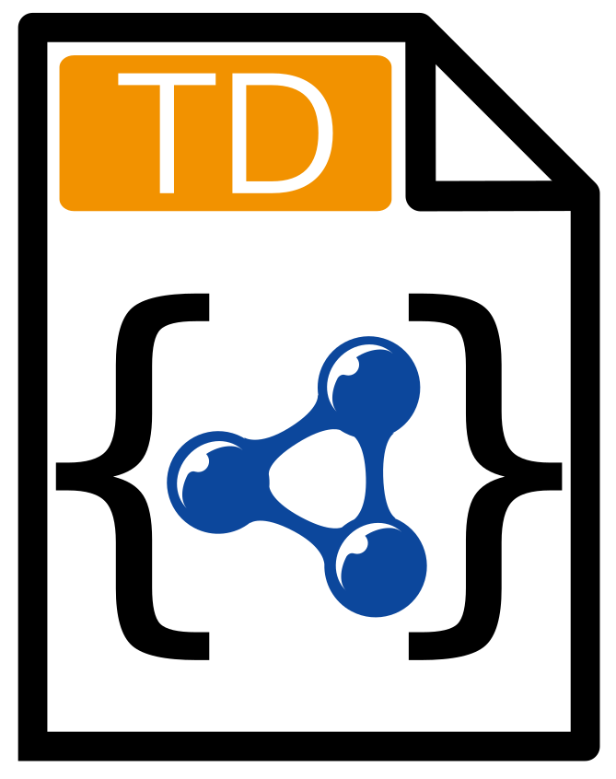


W3C Web of Things (WoT)
W3C Working Group goal: Adapting web technologies to IoT
Already published: Thing Description (TD) metadata format
TD describes the available interactions (network API) of a Thing
New deliverables in progress, including Discovery
How does a potential user obtain the TD for a Thing?
App
App
App
App
App
App
WoT API
WoT API
WoT API
{ properties, actions, events }
MQTT
KNX
TLV
ECHONET
Bearer
EXI
HTTP
OAUTH2
WS
XML
MQTT
KNX
TLV
ECHONET
Bearer
EXI
JSON
Modbus
CBOR
OPC-UA
API Key
HTTP
OAUTH2
CBOR
WS
XML
BACnet
AMQP
JSON
Modbus
BACnet
OPC-UA
API Key
AMQP

Slide 4

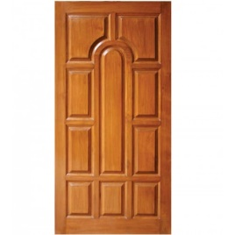

Descriptive Interoperability: TDs
WoT Architecture
Constraints
"Things" must have a TD
Must use URIs, IANA media types, etc.
Thing Description Affordances
Describes WHAT the possible choices are
Describes HOW to interact with the Thing
WoT Thing Description (TD)
{
"@context": [
"https://www.w3.org/2019/wot/td/v1",
{ "iot": "http://iotschema.org/" }
],
"id": "urn:dev:org:32473:1234567890",
"title": "MyLEDThing",
"description": "RGB LED torchiere",
"@type": ["Thing", "iot:Light"],
"securityDefinitions": {
"default": {"scheme": "bearer"}
},
"security": ["default"],
"properties": {
"brightness": {
"@type": ["iot:Brightness"],
"type": "integer",
"minimum": 0,
"maximum": 100,
"forms": [ ... ]
}
},
"actions": {
"fadeIn": {
...
Pull
Handle = Affordance
What?
How?
Door = Thing
Open
Turn

Slide 5
Usage Patterns Overview

Slide 6
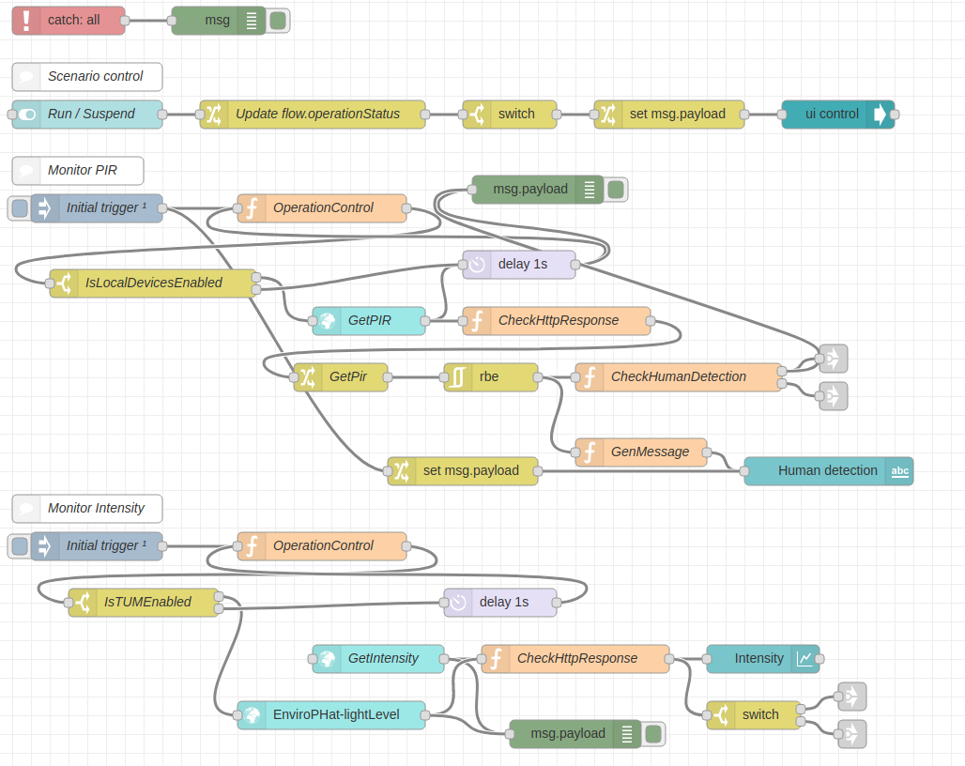

Orchestration
node-wot/Scripting API
Node-RED/node-gen
WoTHelpers.fetch( "coap://localhost:5683/counter" ).then( async (td) => {
// using await for serial execution (note 'async' in then() of fetch())
try {
let thing = await WoT.consume(td);
console.info( "=== TD ===" );
console.info(td);
console.info( "==========" );
// read property #1
let read1 = await thing.readProperty( "count" );
console.info( "count value is" , read1);
// increment property #1 (without step)
await thing.invokeAction( "increment" );
let inc1 = await thing.readProperty( "count" );
console.info( "count value after increment #1 is" , inc1);
// increment property #2 (with step)
await thing.invokeAction( "increment" , {'step' : 3});
let inc2 = await thing.readProperty( "count" );
console.info( "count value after increment #2 (with step 3) is" , inc2);
// decrement property
await thing.invokeAction( "decrement" );
let dec1 = await thing.readProperty( "count" );
console.info( "count value after decrement is" , dec1);
} catch(err) {
console.error( "Script error:" , err);
}
}).catch( (err) => { console.error( "Fetch error:" , err); });

Slide 7
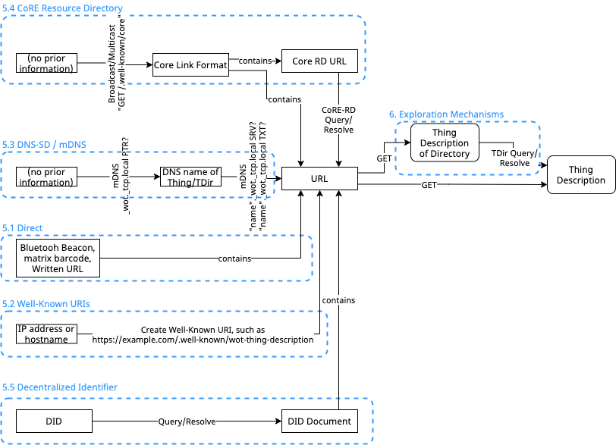
Discovery
Goal: Obtain TD of interest
Not limited to local network
Scalable to many TDs
Need to preserve privacy
Phased access:
Introduction: open
Exploration: controlled
Searchable via JSON Path, XPath, or SPARQL
Future work:
Find "nearby" Things using geospatial data
Phase 1: Introduction
Phase 2: Exploration

Slide 8
Deliverables
New/Updated Normative Documents:
Architecture 1.1: https://github.com/w3c/wot-architecture
Thing Description 1.1: https://github.com/w3c/wot-thing-description
Discovery: https://github.com/w3c/wot-discovery
Profiles: https://github.com/w3c/wot-profile
New/Updated Informative Documents:
Binding Templates: https://github.com/w3c/wot-binding-templates
Scripting API: https://github.com/w3c/wot-scripting-api
Use Cases and Requirements: https://github.com/w3c/wot-usecases
Community Resources:
Web Site: https://www.w3.org/WoT/

Slide 9
Recent Activity
Plugfests
https://github.com/w3c/wot-testing/tree/main/events
New Commercial Usages
Takenaka Construction – Smart Building Information Management systems
Netzo – IoT dashboards and device management
Directory Implementations
WoT Hive, LogiLab (SPARQL based), Fraunhofer LinkSmart
IETF Relationships: JSON Path, CoreRD, COSE/JOSE, ASDF
Under Discussion:
Geospatial data, Embedded JSON Signatures
New Charters/New Deliverables

Slide 10
Use Cases and Requirements
Informative Deliverable: https://github.com/w3c/wot-usecases
Purpose and Process:
Identify specific use cases
Identify application domains
Collect use cases from other W3C groups
Collect use cases from other stakeholders and SDOs
Identify usage patterns
For example, hubs, proxies, automation, etc.
Identify relevant technologies
For example, edge computing, digital twins, etc.
→ Extract common requirements to drive current and future work

Slide 11
Use Cases / Requirements Process
Spec creation (WG)
Use Case TF (IG)
Security
Shortlist
Gaps
TD
Use Case
Use Case
s
Use Case
Requirement
Use Case
Scripting
New Building Block
Discovery
System Architecture / Configuration
Profile
WoT Deliverables

Slide 12
WoT Use Cases Relevant to Smart Cities
Smart City
Geolocation
Dashboard
Interactive Public Spaces
Meeting/Event Assistance
Smart Campus
Cultural Spaces
Health
Public Health Monitoring
Energy
Smart Grids (DER)
Building Technologies
Smart Building
Connected Bldg Energy Efficiency
Automated Smart Bldg Management
Portable Bldg Applications
Retail
All Stop Emergency Plunger
Door Sensor
Freezers and Refrigerators
Restrooms
Lighting
Canopies
Cameras

Slide 13
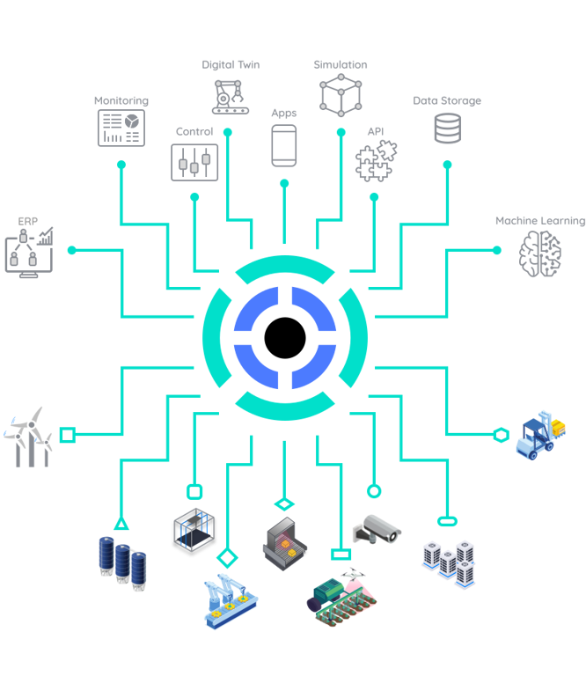
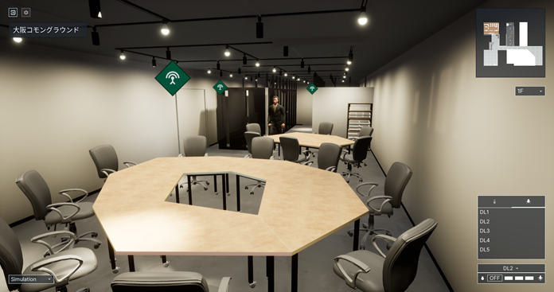

Recent Relevant Applications
https://www.takenaka.co.jp/news/2021/05/02/
Takenaka Corporation
CGLL Platform
BIM applications
https://new.siemens.com/global/en/products/buildings/automation/desigo.html
Siemens
Desigo CC
BIM system
https://netzo.io/
Netzo
IoT Data Hub
Dashboards

Slide 14
Gaps and Discussion
GIS Integration
Geospatial data and discovery
Data Management
Digital Twins and shadows
Event notifications
Data management
Security
Key provisioning and onboarding
Secure LAN access
Proxy services
Access control and ad-hoc sharing
MUDS
Accessibility
Sensory modality mapping
Textual/descriptive interfaces
Service location
Mobility services
Advanced Use Cases
Transportation
Logistics
Distributed energy management
AR visualization
Analytics integration e.g. for health and safety monitoring

Slide 15
Resources and Contacts
https://www.w3.org/WoT
Dr. Michael McCool
Principal Engineer
Intel
Technology Pathfinding
michael.mccool@intel.com
Dr. Sebastian Kaebisch
Senior Key Expert
Siemens
Technology
sebastian.kaebisch@siemens.com

